Slide 1
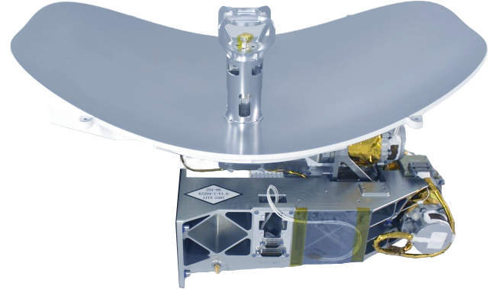
QV Band Reflector Antenna
JL2.941.0019
ISGC-Reflector Antenna Technical Data Sheet
Features
Precise tracking
Ultra-wideband antenna
High gain with dual circular polarization
Modular design with high integration
Light-weight
High reliability with long service life
Equipped with High-performance rotary joint
Equipped with High-performance servo controller
Applications
Test & Measurement
Radar
Military and Space
Satellite
Microwave Radio Systems
Communication Systems
Description
The Inter-Satellite and Ground Communication Reflector Antenna (ISGC-RA) operates in the QV band and provides the functions of inter-satellite communication beam transceiving, satellite-ground communication beam transceiving, and mechanical rotation of the antenna.
The main tasks of the antenna assembly are as follows: After the satellite is successfully inserted into orbit, the antenna is released and deployed to the initial operating position via the hold-down and release mechanism (HDRM) in accordance with the satellite system requirements.The controller receives control commands such as pointing angles, drives the antenna to perform two-degree-of-freedom motion, and completes pointing and tracking tasks toward the designated area.In calibration mode, it can perform tracking scanning based on the feedback energy signals.

Slide 2
QV Band Reflector Antenna
JL2.941.0019
ISGC-Reflector Antenna Technical Data Sheet
Function
Normal Operation Mode
Self-Test Mode
Maintenance Mode
Calibration Mode
Overall Performance
Item | Specification
Total Irradiation Dose | The total dose under 3mm equivalent aluminum shielding for the entire star is approximately 43 KRad（Si）
Lifetime | 7 years
Reliability | > 0.89
Number of Power On/Off Cycles | ≥ 70000 times
Downlink And Uplink Performance
Item | Specification
Operating Frequency | 40GHz～64GHz
Gain | > 41dBi
Rotation Range | ±90°@Azimuth, >247.50°@Elevation
Number Of Rotations Of The Mechanism | More than 500000 times

Slide 3
QV Band Reflector Antenna
JL2.941.0019
ISGC-Reflector Antenna Technical Data Sheet
Thermal Interface
Item | Specification
Storage Temperature Range | ISGC-Antenna: -90℃～+90℃ Antenna Controller: -30℃～+55℃
Working Temperature Range | ISGC-Antenna: -90℃～+90℃ Antenna Controller: -20℃～+55℃
Ground Storage Temperature | -10℃～+45℃
Thermal Control Requirements | 2-way Temperature Measurement & 2-way Temperature Control
Electrial Interface
Item | Specification
Power Supply Interface | Voltage | Rated +42V，Pull Off Range +36V～+45V
 | Working Current | ≤ 1A
 | On-off Contro | Controlled By Antenna Controller
 | Total Power Consumption | ≤0.5W（Standby） ≤12W（Working）
RS422 | Quantity | 2
 | Interface Rate | 115200bps
RF Interface | Downlink | BJ400&BJ500&BJ620 Waveguide Ports
 | Uplink | BJ400&BJ500&BJ620 Waveguide Ports
Notes:
Values at 25℃, sea level.

Slide 4
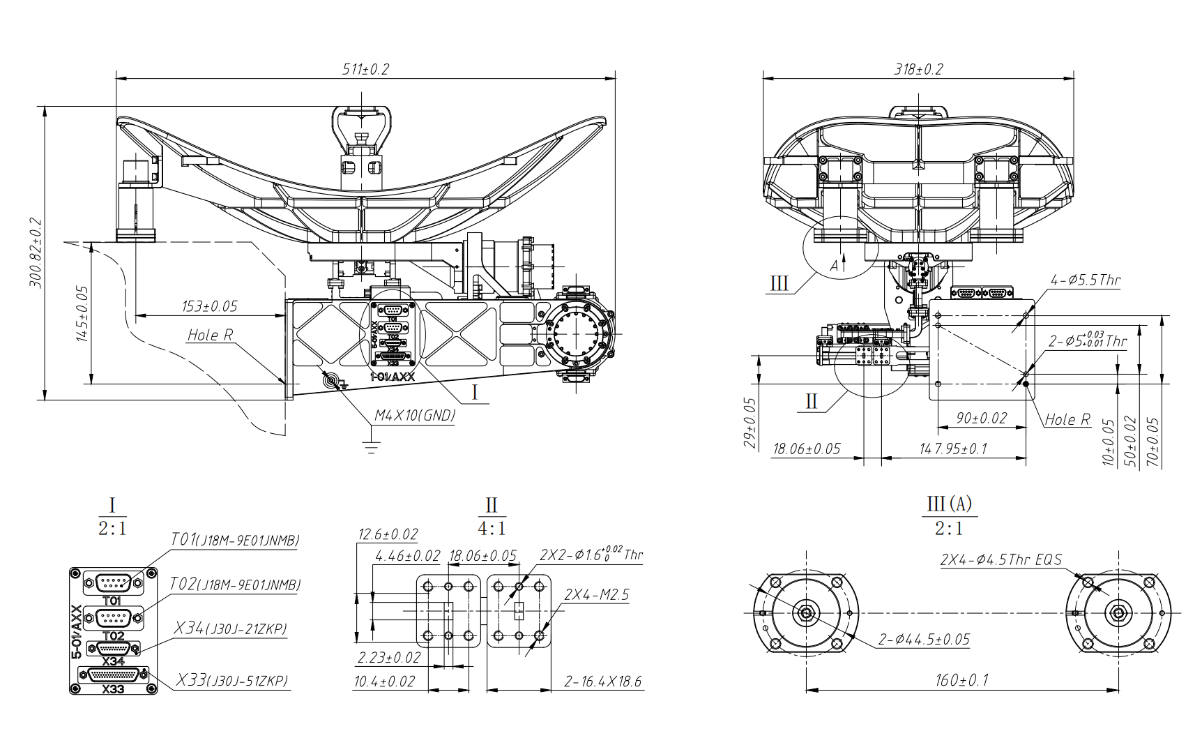


Outline Drawing:
NOTES: 1.UNLESS OTHERWISE SPECIFIED ALL DIMENSIONS ARE NOMINAL. 2.ALL SPECIFICATIONS ARE SUBJECT TO CHANGE WITHOUT NOTICE. 3.DIMENSIONS ARE IN mm.
 | PART NAME
 | QV Band Reflector Antenna
 |  | REV | DATE
Tel: +86 135 1916 6509 |  | V1.0 | 2026.4.9
Website: www.mwglobe.com |  | SCALE 1:1
E-Mail: sales@mwglobe.com
JL2.941.0019

